Slide 1

Archiving System
Multi User Archiving System

Slide 2
- Introduction .
Our enterprise document archiving solution offers multi-user functionality, allowing for a complete, secure and easy-to-use platform that will make your team more productive and your business more profitable.

Slide 3
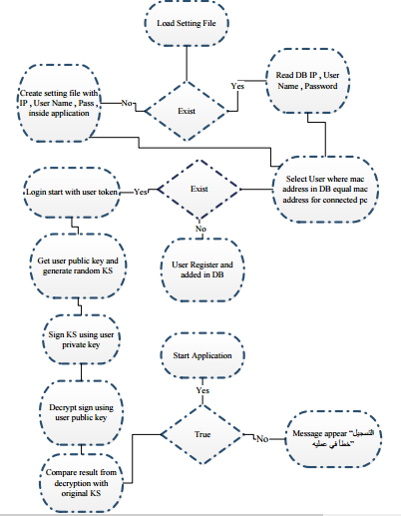

Slide 4
- Configuration and Registration .
First User insert token and connect , login token.
Read setting configuration file and if exist read (IP , User Name , Password) of DB .
If not exist create setting file with information inside application and start application .
DB connection start .
Select user where mac address in DB equal connected mac address for this PC and start Login if there is result in DB.

Slide 5
If there is no result in DB ,Registration operation will start and user added in DB.
If there is no user id in token message appear that “حدث خطأ اثناء عمليه التسجيل”.
If DB Disconnected , open setting form and update in setting configuration file.

Slide 6
- Login .
Login Authentication using Public Key .
If there is result in DB Login operation start.
Get user public key and generated RN (KS).
Sign KS using user private key.
Decrypt sign using user public key.
Compare result from decryption with original RN KS.
If they compared true; application will start – if not : message appear “خطأ في عمليه التسجيل”.

Slide 7
At the beginning of application there are 5 options (مستند جديد ,نوع مستند جديد ,المستندات ,انواع المستندات).
First create “مستند جديد” , insert “اسم نوع المستند” and “اضافه حقل ” and click “ادخال”; after that select “مستند جديد ” and select “نوع المستند” that want to insert its field and click “ادخال”.

Slide 8
- Login Authentication using Certificate
User login using (user name , mac address); send to server to check mac address exist or not.
If exist login operation start and user enter token PIN and get certificate , certificate chain from server.
User get result from server and make chain verification (Main Root)_.

Slide 9
- Insert Document (Image , File) .
Create empty (test.zip) in specific path for receiving file in it .
Generate RN (pass) .
Connect and Login token .
Encrypt RN with server public key .
Create compress file with encrypted pass and send compression file to server .
Sign file with user Private key .
Then insert (Document ID , document type , Sign Path , Encrypted KS) .

Slide 10
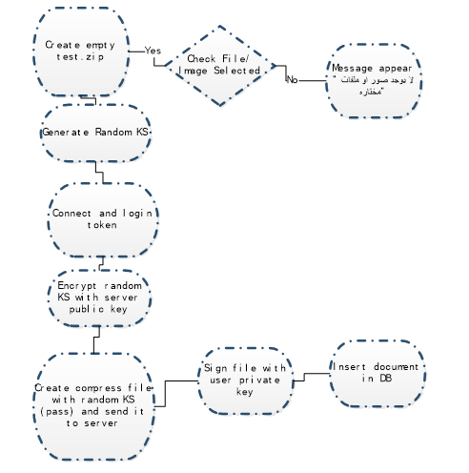
Insert Document Chart :

Slide 11
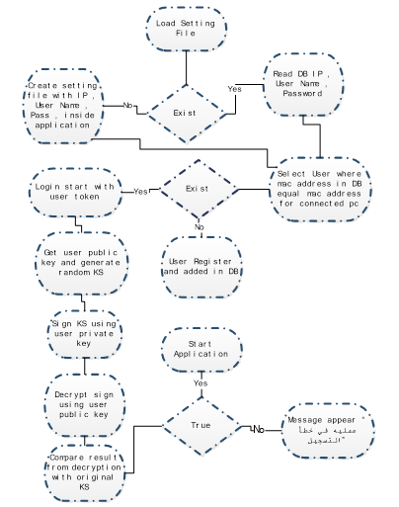
Overall Application Chart :

